Slide 1

ECEN 361
Real-Time and Embedded Systems
Mutual Exclusion

Slide 2
Semaphores
Overview – There are two reasons to use a semaphore
Binary Semaphores and Synchronization – Used to pace a task
Mutual Exclusion – Used to protect a shared resource
Notes:
What are semaphores?
How are they used

Slide 3
Overview
A Semaphore is a kernel primitive object. Semaphore operations:
  Can change a task’s state.
  Are fast.
Two semaphore types available:
  Binary semaphores allow a task to pend until a given event occurs (e.g., an interrupt).
  Mutual exclusion semaphores allow a task to acquire an exclusive lock on a shared resource (e.g., a file or a device).
  Counting semaphores are available:
    Less commonly used.
    See manual pages for details.

Slide 4
Semaphores
Overview – There are two reasons to use a semaphore
Binary Semaphores and Synchronization – Used to pace a task
Mutual Exclusion – Used to protect a shared resource
Notes:
What are semaphores?
How are they used

Slide 5
The Synchronization Problem
myGetData ( )
{
requestData( );
waitForData( );
getData( );
}
Task
Task may need to wait for an event to occur.
Busy waiting (i.e., polling) is inefficient.
Pending until the event occurs is better.

Slide 6
The Synchronization Solution
Create a binary semaphore for the event.
Binary semaphores exist in one of two states:
  Full (event has occurred).
  Empty (event has not occurred).
Task waiting for the event calls semTake( ) and blocks until semaphore is given.
Task or interrupt service routine detecting the event calls semGive( ), which unblocks the waiting task.

Slide 7
Taking a Semaphore
STATUS semTake (semId, timeout)
    semId The SEM_ID returned from semBCreate( ).
    timeout Maximum time to wait for semaphore. Value can be clock ticks, WAIT_FOREVER, or NO_WAIT.
Can pend the task until either
  Semaphore is given or
  Timeout expires.
Semaphore left unavailable.
Returns OK if successful, ERROR on timeout (or invalid semId).

Slide 8
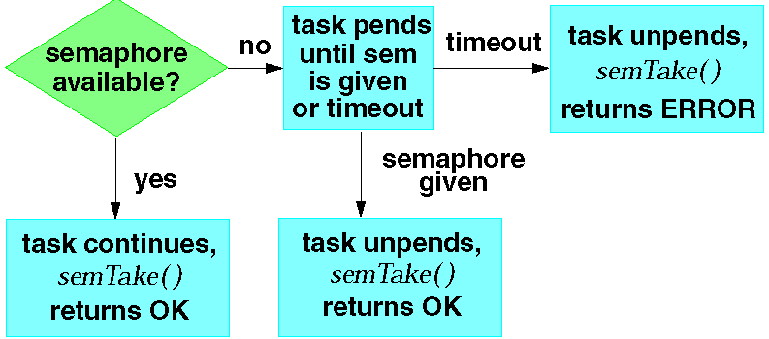
Taking a Binary Semaphore
Notes:
The semaphore is always left unavailable after a semTake( ).

Slide 9
Giving a Semaphore
STATUS semGive (semId)
Unblocks a task waiting for semId.
If no task is waiting, makes semId available.
Returns OK, or ERROR if semId is invalid.
Notes:
Unblocking a higher priority task will preempt caller of semGive( ).

Slide 10
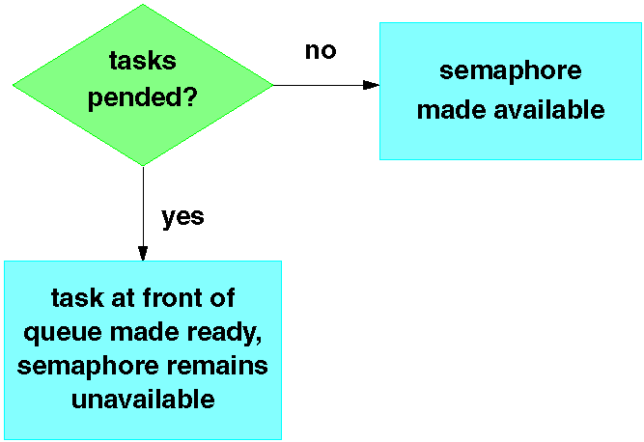
Giving a Binary Semaphore
Notes:
@ See the code example “Synchronization Solution” on page 2 of appendix A.

Slide 11
Problem - Information Leakage
Fast event occurrences can cause information loss.
Suppose a task (priority=100) is executing the following code, with semId initially unavailable:
FOREVER
{
semTake (semId, WAIT_FOREVER);
printf (“Got the semaphore\n”);
}

Slide 12
Problem - Information Leakage
What would happen in the scenarios below?
  1. -> repeat(1, semGive, semId)
  2. -> repeat(2, semGive, semId)
  3. -> repeat(3, semGive, semId)
FOREVER
{
semTake (semId, WAIT_FOREVER);
printf (“Got the semaphore\n”);
}

Slide 13
Synchronizing Multiple Tasks
STATUS semFlush (semId)
Unblocks all tasks waiting for semaphore.
Does not affect the state of a semaphore.
Useful for synchronizing actions of multiple tasks.
Notes:
This routine is not available for mutual exclusion semaphores.

Slide 14
Semaphores
Overview – There are two reasons to use a semaphore
Binary Semaphores and Synchronization – Used to pace a task
Mutual Exclusion – Used to protect a shared resource
Notes:
What are semaphores?
How are they used

Slide 15
Mutual Exclusion Problem
Some resources may be left inconsistent if accessed by more than one task simultaneously.
  Shared data structures
  Shared files
  Shared hardware devices
Must obtain exclusive access to such a resource before using it.
If exclusive access is not obtained, then the order in which tasks execute affects correctness.
  We say a race condition exists.
  Very difficult to detect during testing.
Mutual exclusion cannot be compromised by priority.

Slide 16
RR with Interrupt - Code Example
static int iTemperatures[2];
void interrupt vReadTemperatures (void)
{
iTemperatures[0] = !! read in value from HW
iTemperatures[1] = !! read in value from HW
}
void main (void)
{
int iTemp0, iTemp1;
while (TRUE)
{
iTemp0 = iTemperatures[0];
iTemp1 = iTemperatures[1];
if (iTemp0 != iTemp1)
!! Set off howling alarm;
!! Do other processing
}
}
Assume interrupt asserted at regular intervals, based on a timer, or when either temperature changes
What was the problem here?

Slide 17
Is the problem fixed?
static int iTemperatures[2];
void interrupt vReadTemperatures (void)
{
iTemperatures[0] = !! read in value from HW
iTemperatures[1] = !! read in value from HW
}
void main (void)
{
while (TRUE)
{
if (iTemperatures[0] != iTemperatures[1])
!! Set off howling alarm;
}
}

Slide 18
Consider the Assembly Language Sequence
static int iTemperatures[2];
void interrupt vReadTemperatures (void)
{
iTemperatures[0] = !! read in value from HW
iTemperatures[1] = !! read in value from HW
}
void main (void)
{
while (TRUE)
{
if (iTemperatures[0] != iTemperatures[1])
!! Set off howling alarm;
}
}
….
mov r1, (itemperatures[0])
mov r2, (itemperatures[1])
cmp r1, r2
je okay
; set off alarm
okay: ….
So, how could we solve this?

Slide 19
One Solution – Disable Interrupts
static int iTemperatures[2];
void interrupt vReadTemperatures (void)
{
iTemperatures[0] = !! read in value from HW
iTemperatures[1] = !! read in value from HW
}
void main (void)
{
int iTemp0, iTemp1;
while (TRUE)
{
disable Interrupt();
iTemp0 = iTemperatures[0];
iTemp1 = iTemperatures[1];
enableInterrupt ();
if (iTemp0 != iTemp1)
!! Set off howling alarm;
}
}

Slide 20
Second Solution - Semaphores
Create a mutual exclusion semaphore to guard the resource.
Call semTake( ) before accessing the resource; call semGive( ) when done.
  semTake( ) will block until the semaphore (and hence the resource) becomes available.
  semGive( ) releases the semaphore (and hence access to the resource).

Slide 21
Creating Mutual Exclusion Semaphores
SEM_ID semMCreate (options)
options can be:
    queue specification SEM_Q_FIFO or
    SEM_Q_PRIORITY
    deletion safety SEM_DELETE_SAFE
    priority inheritance SEM_INVERSION_SAFE
Initial state of semaphore is available.
Notes:
Symbolic constants defined in semLib.h.
Queue specification determines the order in which tasks waiting for the semaphore should unblock.
Deletion safety and priority inheritance will be discussed later.

Slide 22
Mutex Ownership
A task which takes a mutex semaphore “owns” it, so that no other task can give this semaphore.
Mutex semaphores can be taken recursively.
  The task which owns the semaphore may take it more than once.
  Must be given same number of times as taken before it will be released.
Mutual exclusion semaphores cannot be used in an interrupt service routine.
Notes:
A mutex may be given regardless of ownership by calling the semMGiveForce( ) function. This is primarily intended as a debugging aid, but the function might be used in a recovery task if the task owning the mutex dies, and the resource guarded by the mutex can be reset to a consistent state.

Slide 23
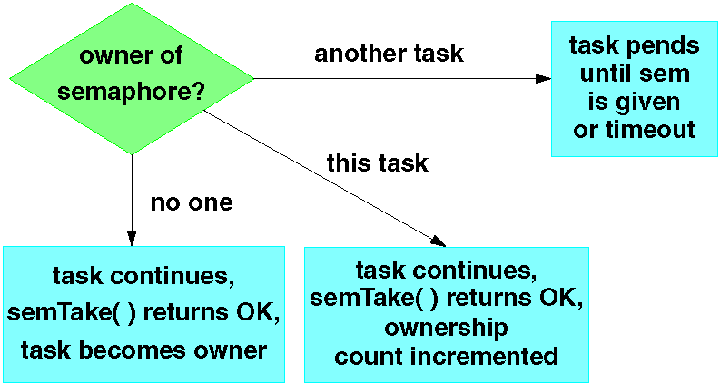
Taking a Mutex Semaphore
Notes:
Difference from binary semaphores:
Can be taken more than once by a task without blocking.

Slide 24
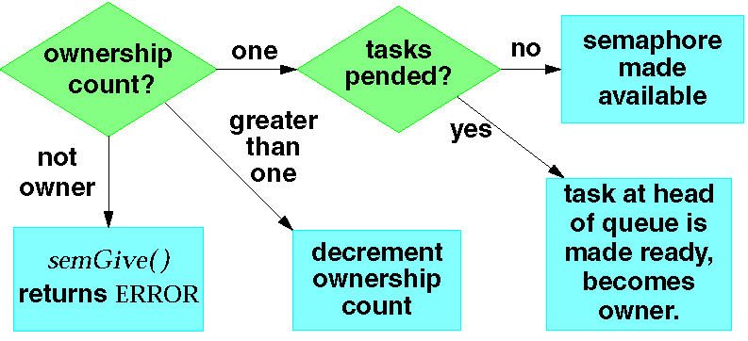
Giving a Mutex Semaphore
Notes:
Difference from binary semaphore:
Only the owner of a semaphore can give it.
The owner may take the semaphore more than once, but must give it as many times as it was taken in order to release it.

Slide 25
Code Example - Solution
1 #include “vxWorks.h”
2 #include “semLib.h”
3
4 LOCAL char myBuf[BUF_SIZE];/* Store data here */
5 LOCAL int myBufIndex = -1;/* Index of last data */
6 LOCAL SEM_ID mySemId;
7
8 void myBufInit( )
9 {
10 mySemId = semMCreate(SEM_Q_PRIORITY |
11 SEM_INVERSION_SAFE |
12 SEM_DELETE_SAFE);
13 }
14
15 void myBufPut (char ch)
16 {
17 semTake(mySemId,WAIT_FOREVER);
18 myBufIndex++;
19 myBuf[myBufIndex]=ch;
20 semGive(mySemId);
21 }

Slide 26
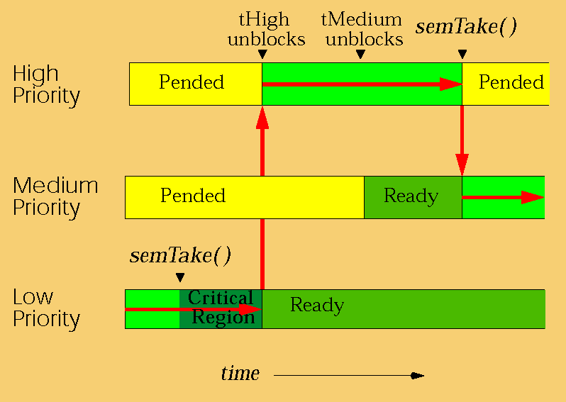
Unbounded Priority Inversion
Notes:
High and low priority tasks share a resource. Medium priority task has nothing to do with the resource whatsoever.
High-priority task blocks on a mutex semaphore held by low-priority task.
Can’t continue until low priority task calls semGive( ).
Critical region is short, so low-priority task will call semGive( ) soon if given a chance to run.
Low-priority task is preempted by medium-priority task, which is not involved in the mutual exclusion.
Low-priority task can’t complete its (very short) critical region.
This prevents the high-priority task from running.

Slide 27
Priority Inheritance
Priority inheritance algorithm solves the unbounded priority inversion problem.
Task owning a mutex semaphore is elevated to priority of highest priority task waiting for that semaphore.
Enabled on mutex semaphores by specifying the SEM_INVERSION_SAFE option during semMCreate( ).
Must also specify SEM_Q_PRIORITY (SEM_Q_FIFO is incompatible with SEM_INVERSION_SAFE).

Slide 28
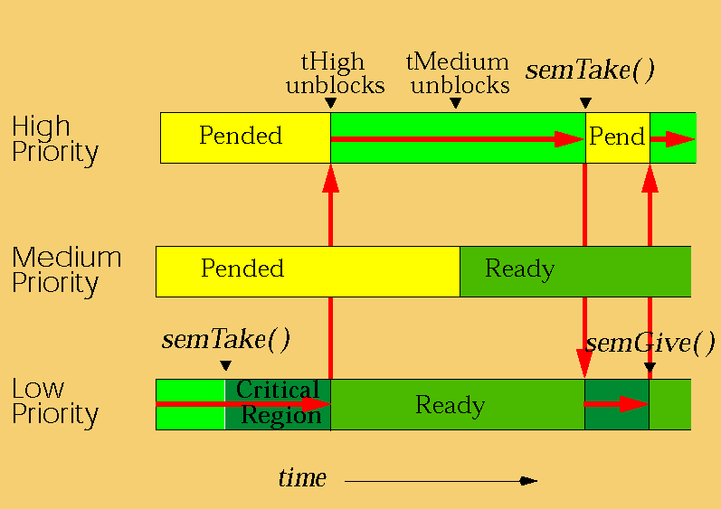
Priority Inversion Safety
Notes:
The low-priority task is allowed to finish its critical region at the same priority as the high-priority task.
The low-priority task returns to its original priority when it has given up all the inversion-safe mutexes which it owns.

Slide 29
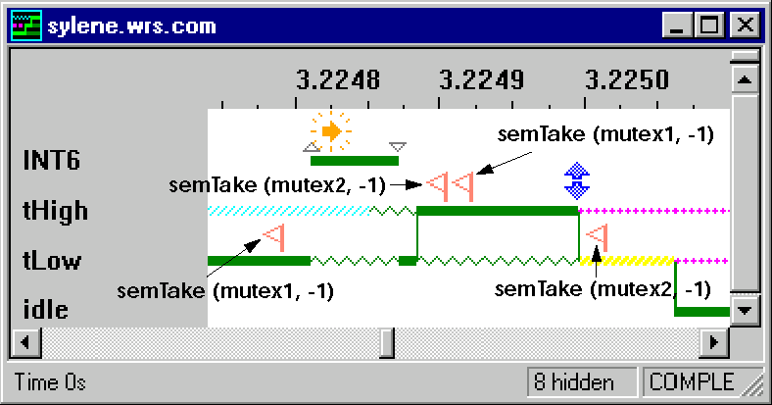
Caveat - Deadlocks
A deadlock is a race condition associated with the taking of multiple shared resources.
May be very difficult to detect during testing.
Notes:
Common solutions to potential deadlock situations:
Use only one semaphore to protect resources that will be accessed together.
Sequence accesses to resources. In above example, all tasks would take semId1 before attempting to take semId2.
In the WindView graph, note that WindView can distinguish between the time at which a blocking call to semTake() is logged, and the slightly later time at which the resulting context switch occurs. The above sequence takes not quite 300 μs on a 25 MHz 68k board. INT6 is the system clock interrupt level.

Slide 30
Deadlocks – Two Solutions
Move all the individual semaphores into a single semaphore
2) Enforce an order for taking semaphores
Notes:
Common solutions to potential deadlock situations:
Use only one semaphore to protect resources that will be accessed together.
Sequence accesses to resources. In above example, all tasks would take semId1 before attempting to take semId2.
In the WindView graph, note that WindView can distinguish between the time at which a blocking call to semTake() is logged, and the slightly later time at which the resulting context switch occurs. The above sequence takes not quite 300 μs on a 25 MHz 68k board. INT6 is the system clock interrupt level.

Slide 31
Other Caveats
Keep the critical region (code between semTake( ) and semGive( )) short.

Slide 32
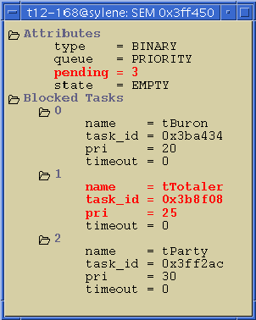
Semaphore Browser
To inspect the properties of a specific semaphore, insert the semaphore ID in the Browser’s Show box, and click on Show.
Notes:
A displayed timeout of zero signifies a WAIT_FOREVER.

Slide 33
Locking Out Preemption
When doing something quick frequently, it may be preferable to disable preemption instead of taking a mutex.
Call taskLock( ) to disable preemption.
Call taskUnlock( ) to reenable preemption.
Does not disable interrupts.
If the task blocks, preemption is reenabled. When the task continues executing, preemption is again locked.
Prevents all other tasks from running, not just the tasks contending for the resource.
Notes:
taskLock( )/taskUnlock( ) is faster than semGive( )/semTake( ).
Keep the critical region short to avoid increasing latency in the system.
taskLock( ) increments a variable lockCnt in the TCB of the task making the call. If this variable is greater than zero when a preemption would ordinarily ocurr, the current task is not preempted. If the task blocks within the critical region and later unblocks, this count is still incremented, so preemption is once more locked out. taskUnlock() decrements the lock count, and checks whether a reschedule must occur when the count reaches zero.
Be VERY cautious making blocking calls within a taskLock() /taskUnlock() critical region, as preemption lockout will be lost. Occasionally it is valid to block in such a region when it is only important that preemption be locked out before or after the block.

Slide 34
ISR’s and Mutual Exclusion
ISR’s can’t use mutex semaphores.
Task sharing a resource with an ISR may need to disable interrupts.
To disable/re-enable interrupts:
int intLock( )
void intUnlock (lockKey)
  lockKey is return value from intLock( ).
Keep interrupt lock-out time short (e.g., long enough to set a flag)!
Making kernel calls at task level can reenable interrupts!
Notes:
May be called from interrupt or task time.
intLock( ) does not prevent context switch, which will occur if:
Task blocks (e.g., calls semTake( ), malloc( ), etc.).
Task unblocks a higher priority task (e.g., semGive( )).
Interrupts are unlocked whenever a task making a kernel call exits kernel state (usually just before returning from the call). Calling kernel functions within intLock() / intUnlock() in a task may thus reenable interrupts and so compromises mutual exclusion.
ISR stands for interrupt service routine.

Slide 35
Summary
Binary Semaphores allow tasks to pend until some event occurs.
  Create a binary semaphore for the given event.
  Tasks waiting for the event blocks on a semTake( ).
  Task or ISR detecting the event calls semGive( ) or semFlush( ).
Caveat: if the event repeats too quickly, information may be lost.

Slide 36
Summary
Mutual Exclusion Semaphores are appropriate for obtaining exclusive access to a resource.
  Create a mutual exclusion semaphore to guard the resource.
  Before accessing the resource, call semTake( ).
  To release the resource, call semGive( ).
Mutex semaphores have owners.
Caveats:
  Keep critical regions short.
  Can’t be used at interrupt time.
  Deadlocks.

Slide 37
Summary
taskLock( )/taskUnlock( ):
  Prevents other tasks from running.
  Use when doing something quick frequently.
  Caveat: keep critical region short.
intLock( )/intUnlock( ):
  Disables interrupts.
  Use to protect resources used by tasks and interrupt service routines.
  Caveat: keep critical region short.

